Slide 1

Coronavirus Over The World
Or itskovich
Link to GitHub

Slide 2


Slide 3

Can we predict which TOP 3 countries will have the largest number of
Deaths there be with the number of population ?

Slide 4

Data Sources

Slide 5
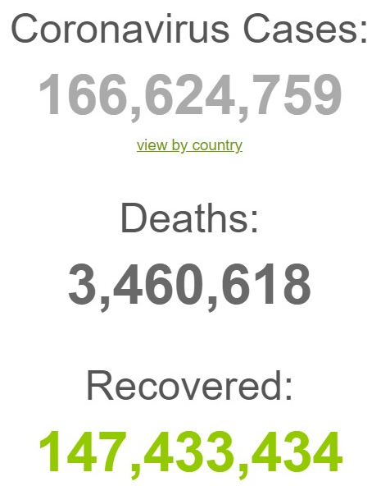


Crawling :
WORLDOMETER
WIKIPEDIA

Slide 6

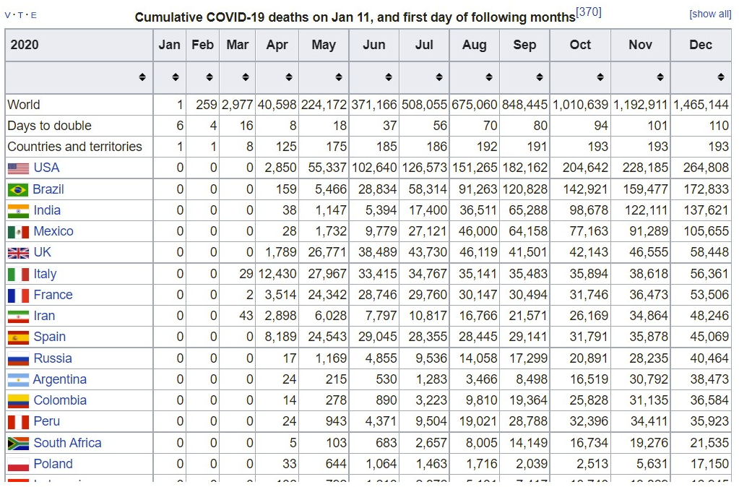
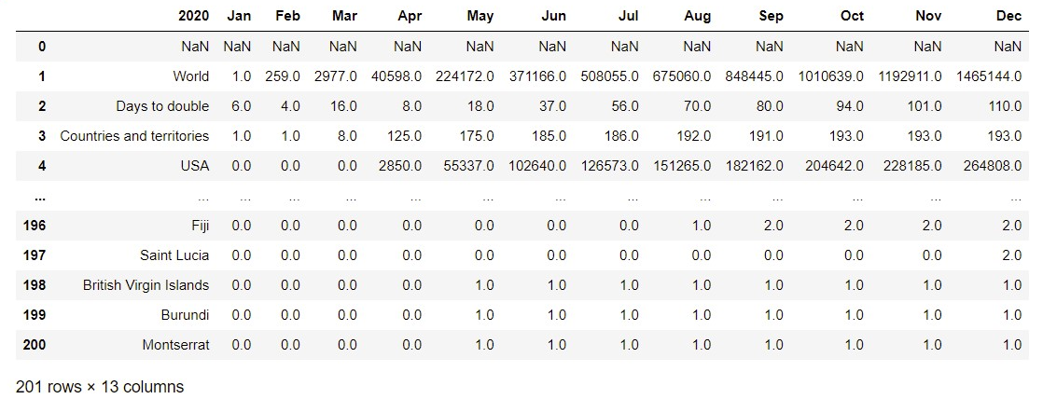
Wikipedia :
We used a bult-in functions to crawl the relevant table from the site.
With this table we can check the data and answer our research question.
we took some tables from Wikipedia and merge between them

Slide 7
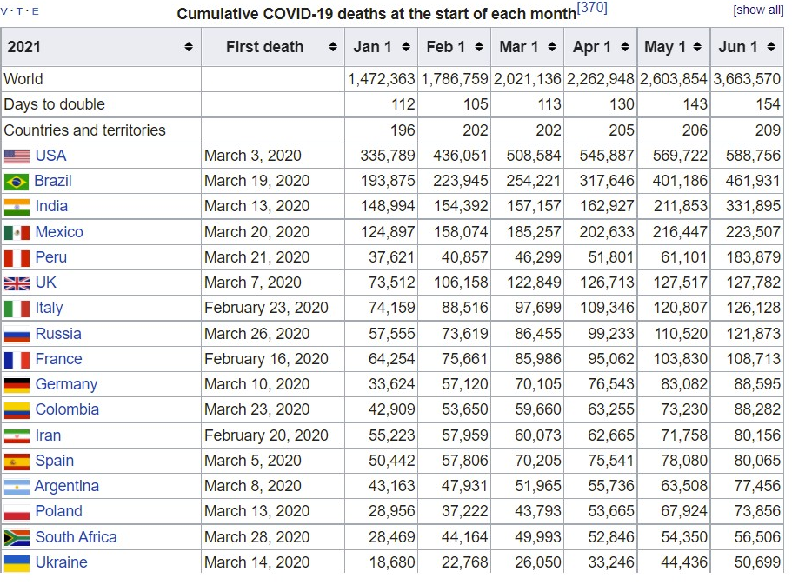
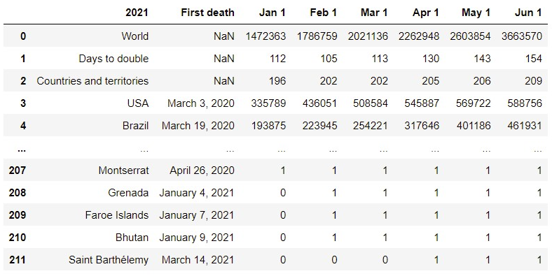
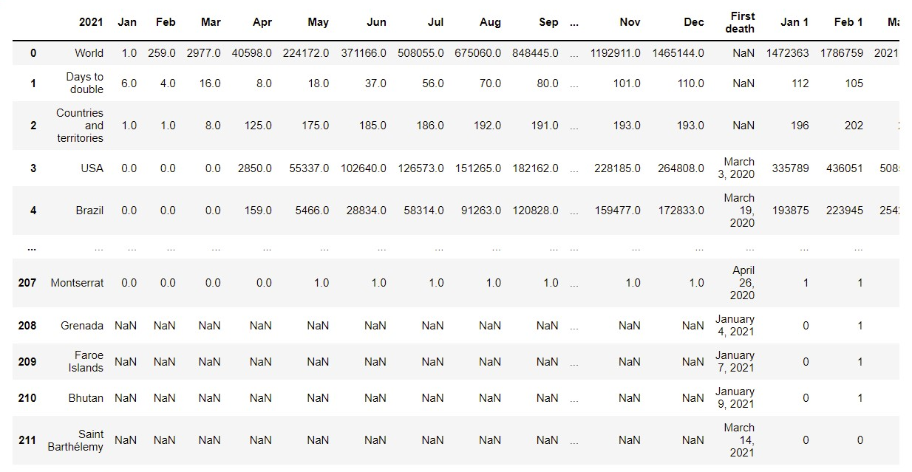

The merge table

Slide 8
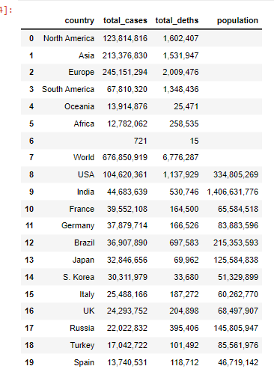
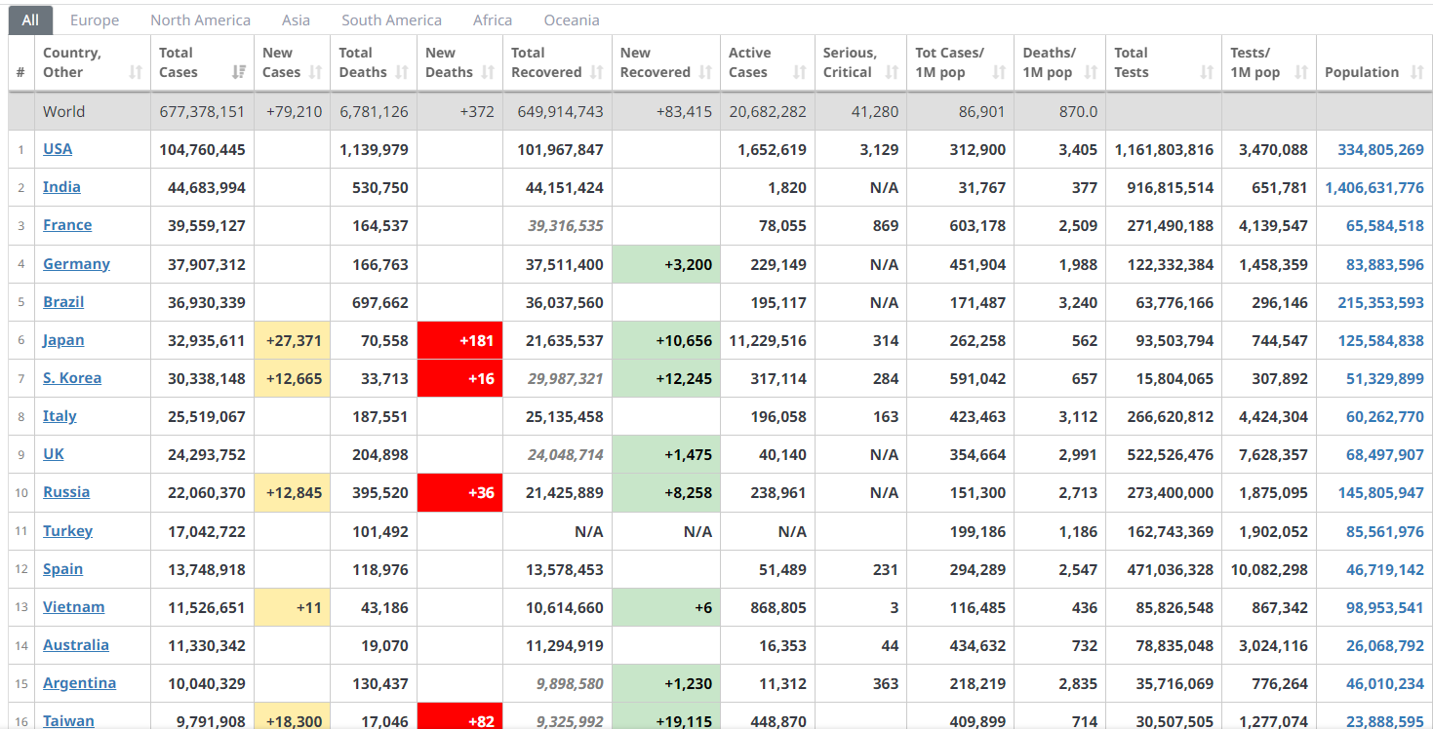
WORLDOMETER :
I used a bult-in functions to crawl the relevant table from the site.
I take specific columns from the table in the site of WORLDOMETER I
can check the data and answer our research question.

Slide 9


Slide 10

Data Cleaning :
I had a lot of problems with the tables. I want to take the column from WORLDOMETER and put
it to the merge table that i took from WIKIPEDIA,
But i had to put the correct values per country names.
i try to check my goal and do some math operations but i had a lot of ERORRS.
The columns from the site of WORLDOMETER where strings,
By the command that i learned I hecked this – dataframe.dtypes
The columns are int and my is string so I cant do math operations try to change this,
But I had another problems, the column of ‘POPULATION’ had
“NONE” and blank values and the numbers where in string and had the char ‘ , ‘ between the numbers
So i change it

Slide 11
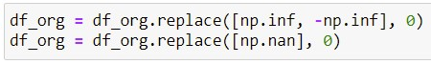
After doing mathematical operations, there will be a lot of data that is not needed, such as 0 values, so I clean the table and "throw away" data that I do not need for my mathematical operations

Slide 12

EDA

Slide 13
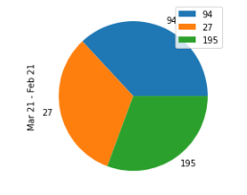
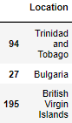
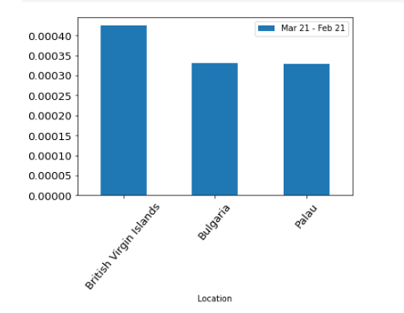
Pie&Bar Plot,
Top 3 countries with the highest deaths in MAR
Bar Plot,
Top 20 countries with the highest deaths in Feb and Mar
This countries is the top because we did math operations :
I take the last month that had the number of deaths
i divided it to the population
I had the % of each country, how many deaths there is.

Slide 14
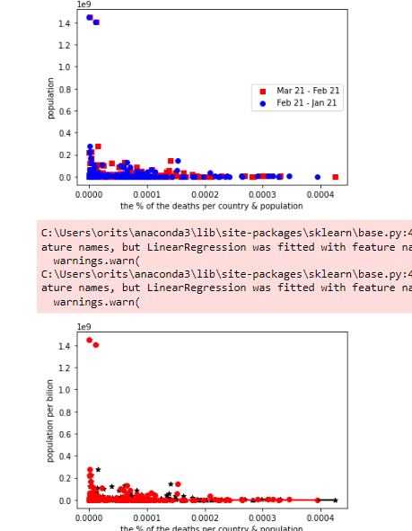
Linear regression
Using the sklearn for linear regression
Basic data set visualization for hints for regression results

Slide 15

Machine Learning

Slide 16

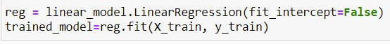
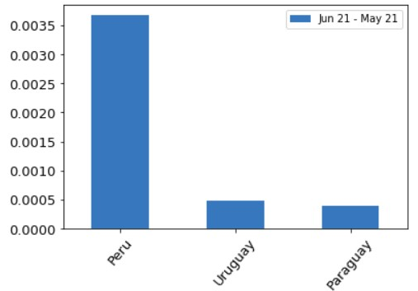
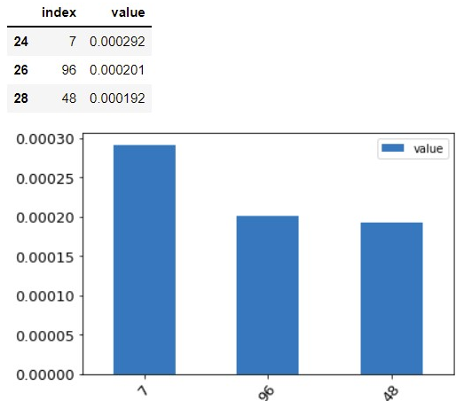
Using library and linear regression I were able to train a model that predicts witch top 3
Countries there will be the large number of deaths with population.
Our project
The predict

